Slide 1
Reno Clouds on March 4th 2026 at 8:30 am LST 16:30 UTC
Model results from NAM 3K, soundings.
https://www.tropicaltidbits.com/analysis/models/?model=nam3km&region=swus&pkg=cfracmid&runtime=2026030412&fh=1

Slide 2
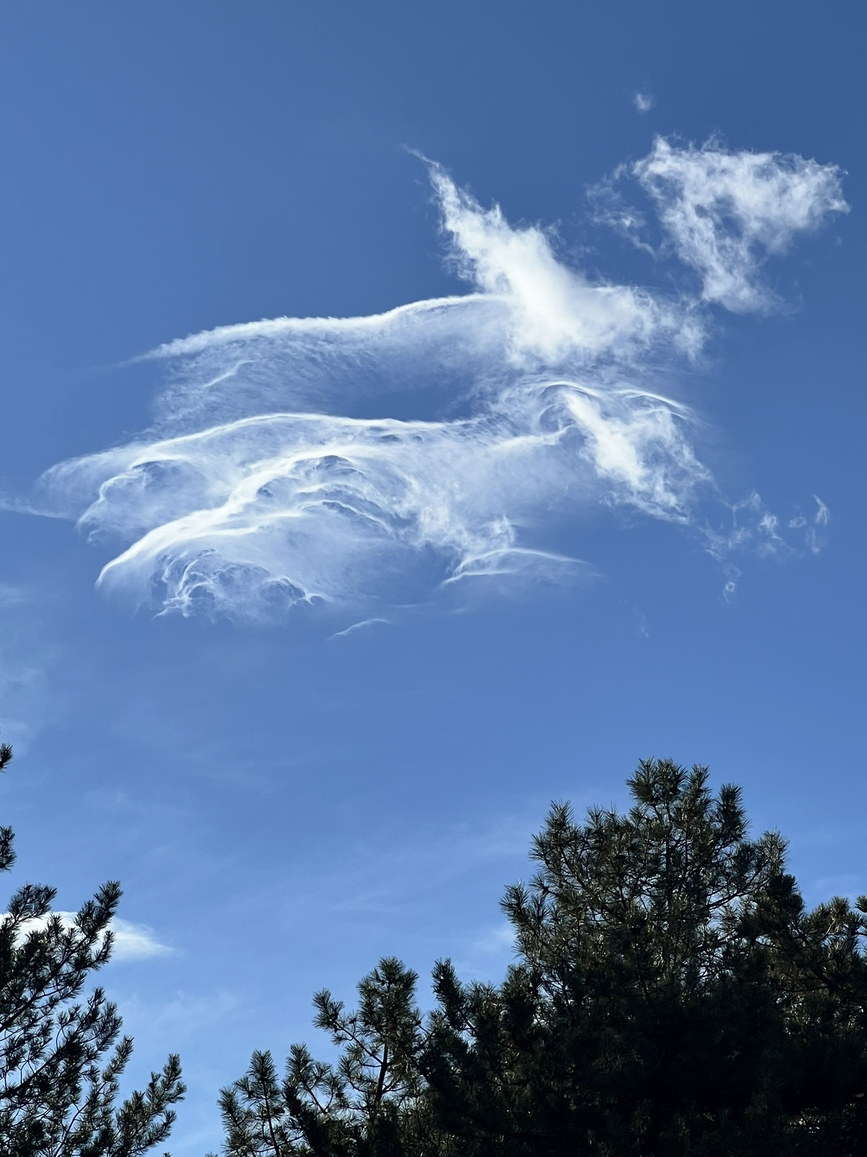

Slide 3


Slide 4
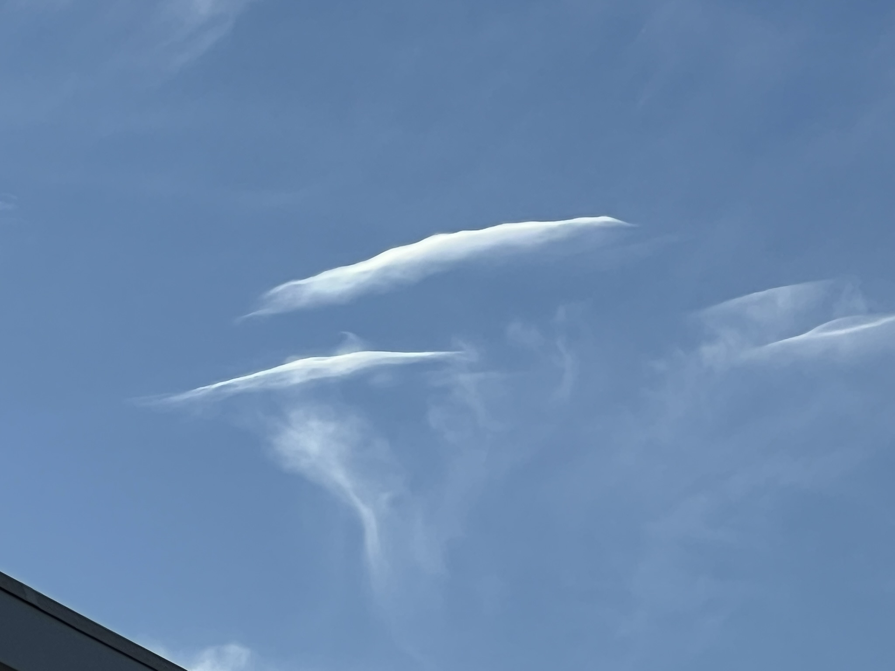

Slide 5
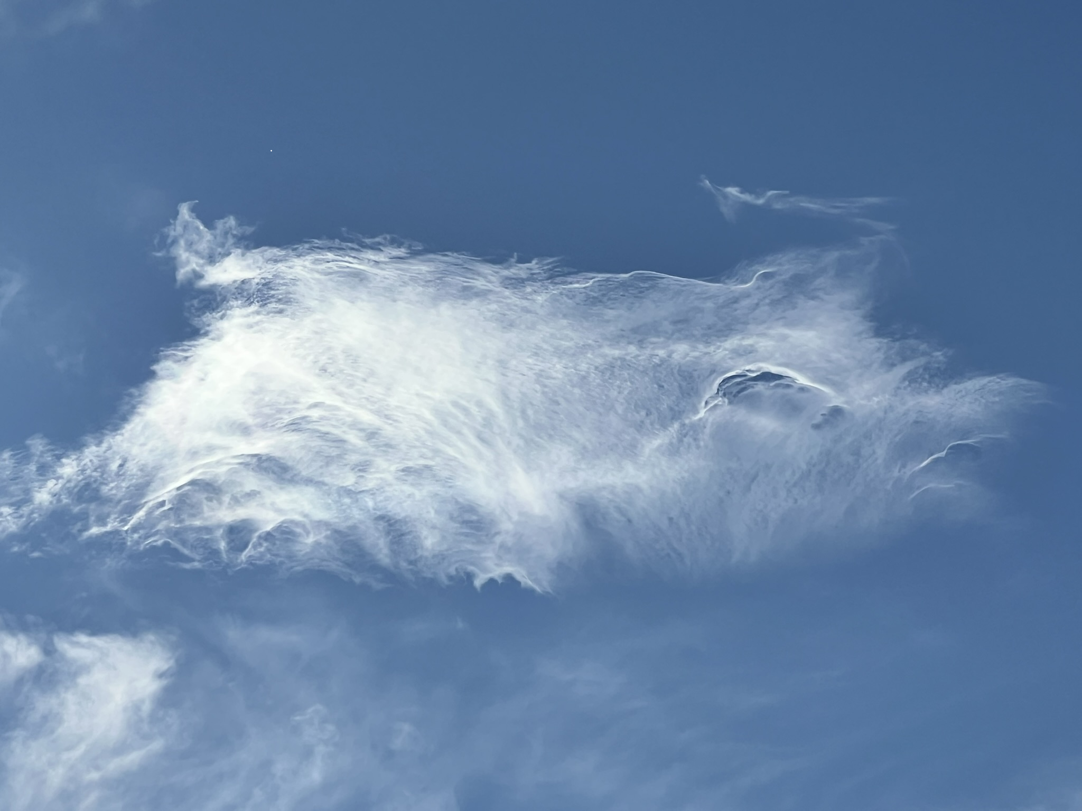

Slide 6
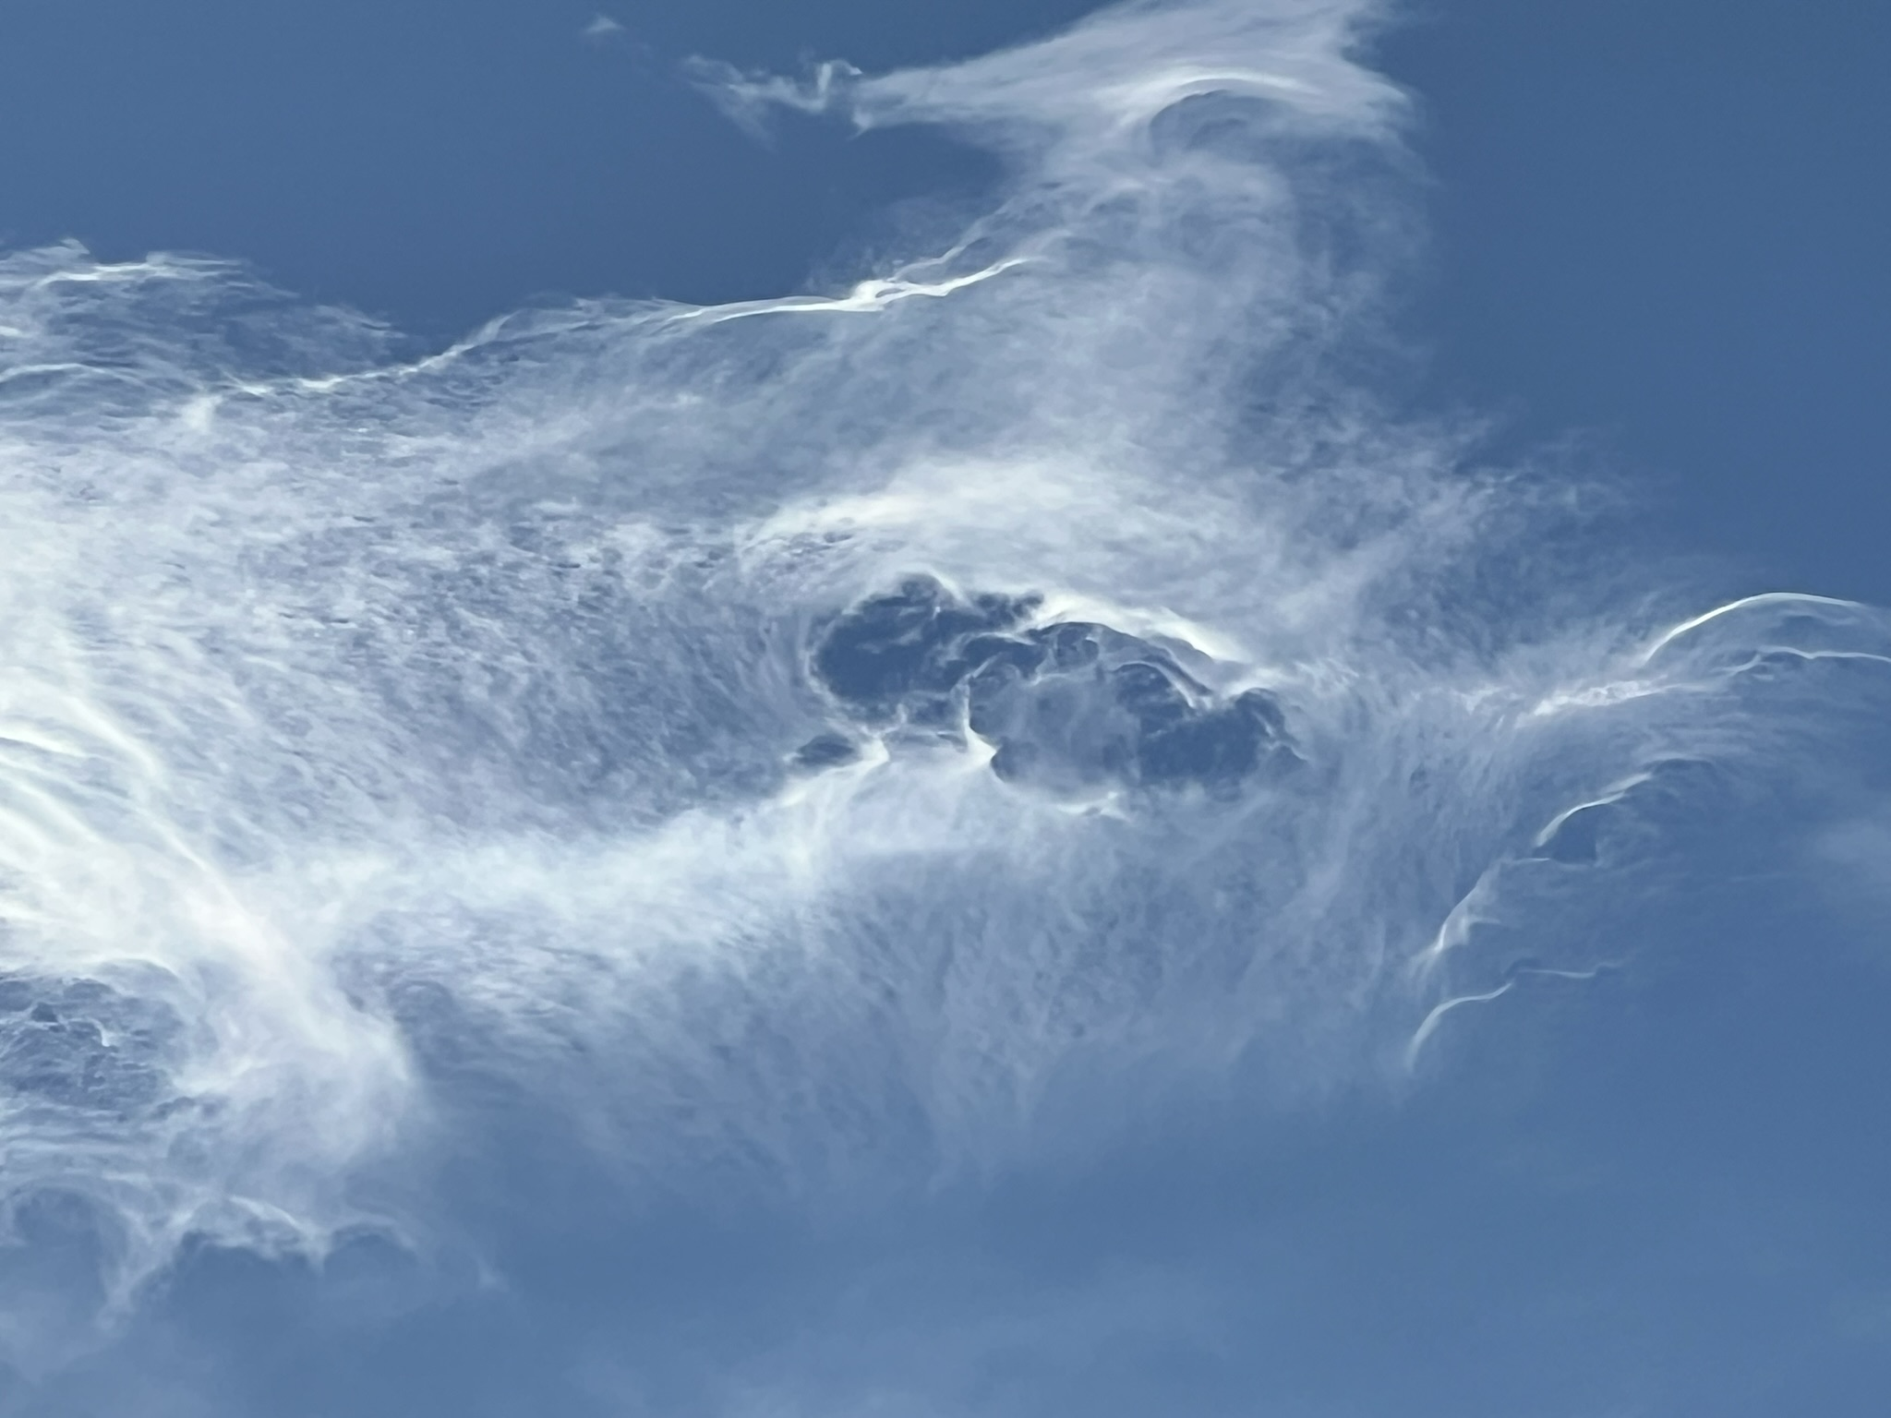

Slide 7


Slide 8
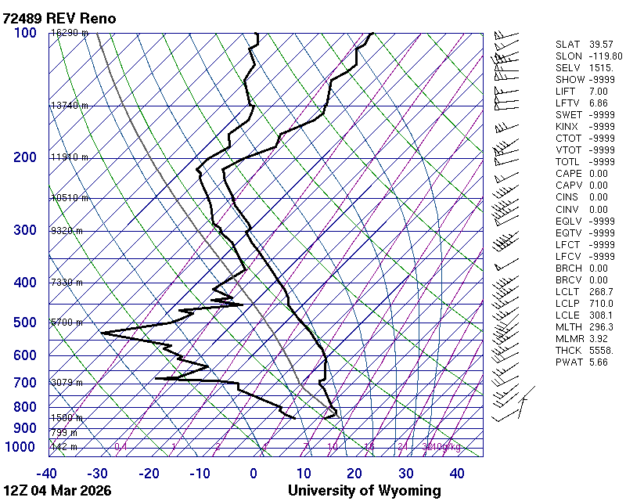
4 a.m. LST

Slide 9
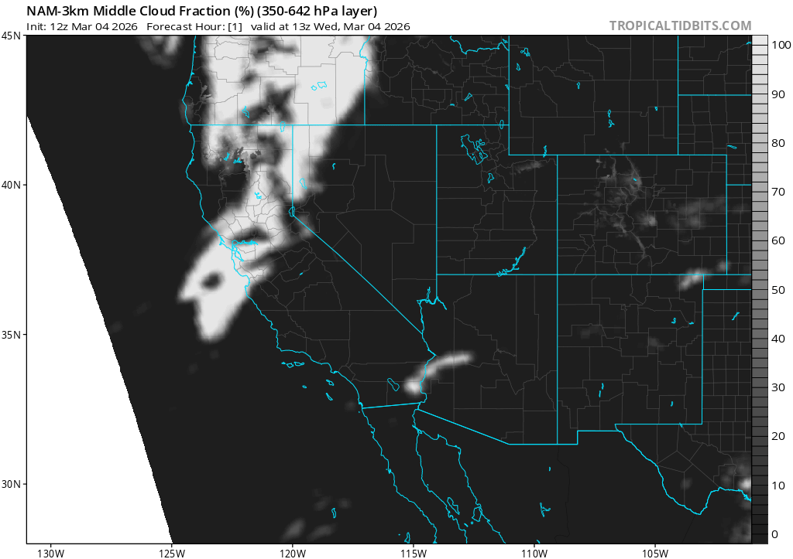

Slide 10
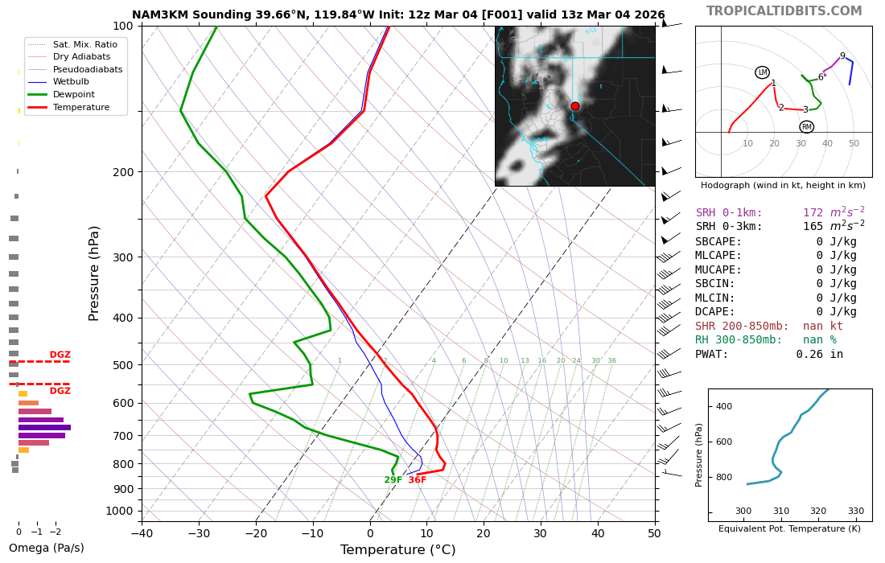

Slide 11
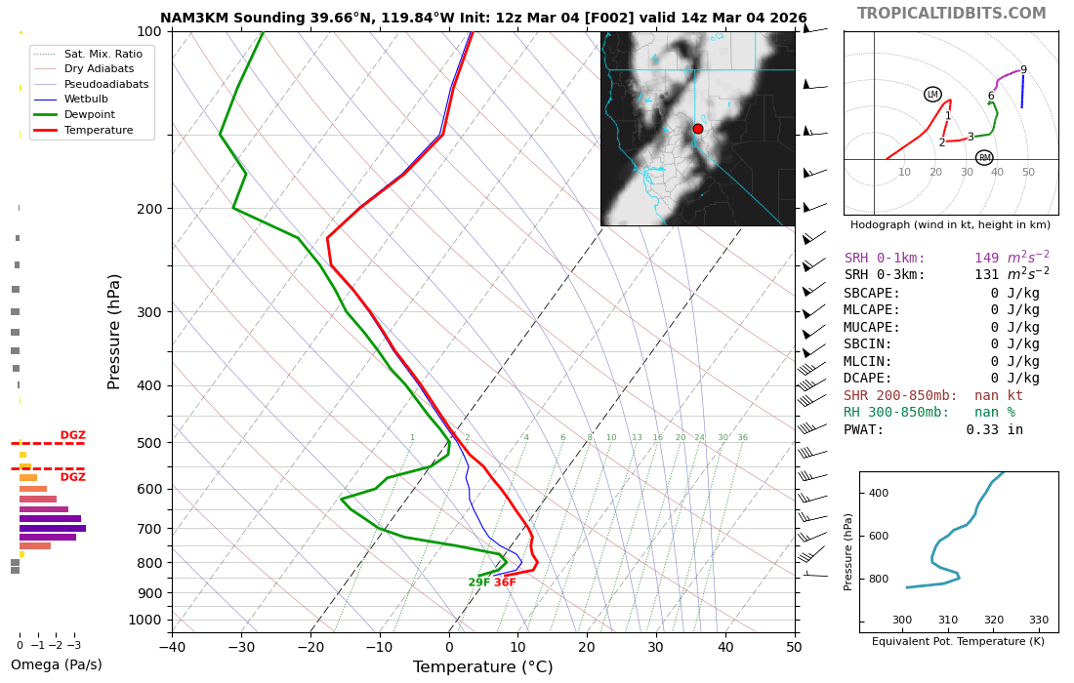

Slide 12
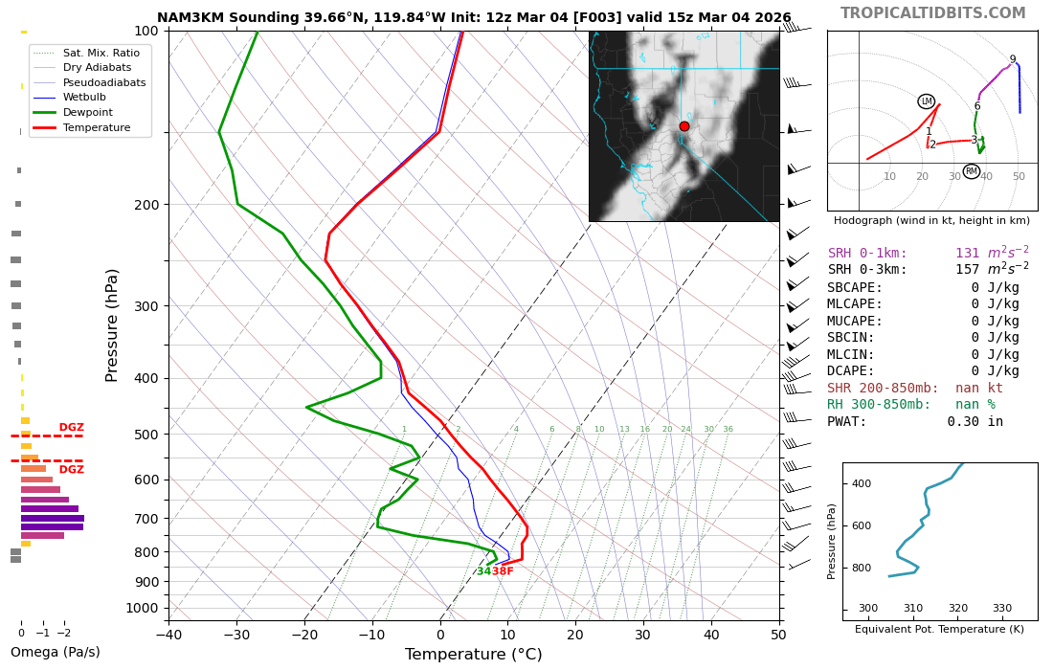

Slide 13
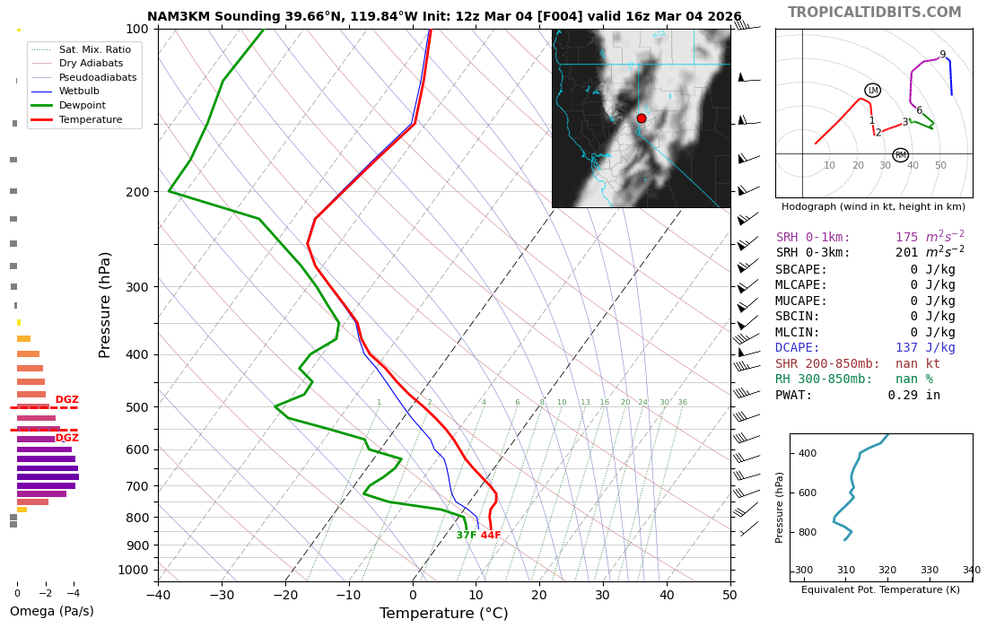

Slide 14
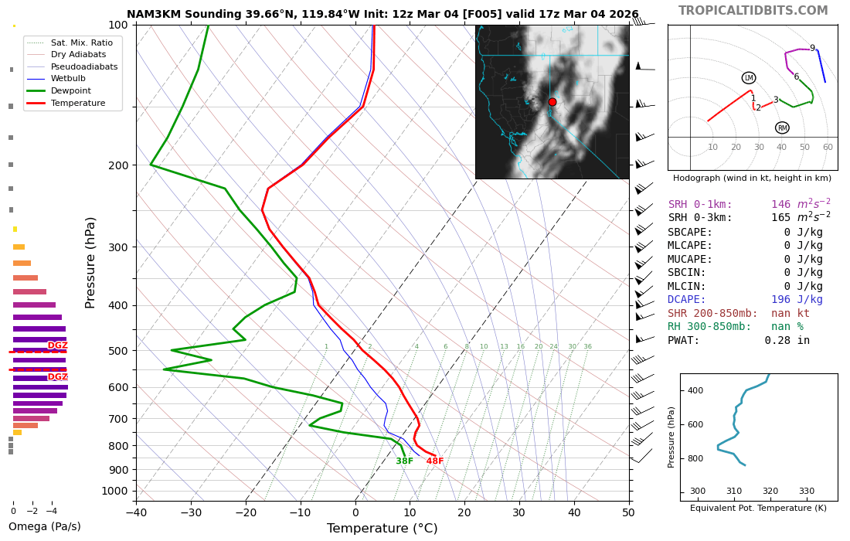

Slide 15


Slide 16
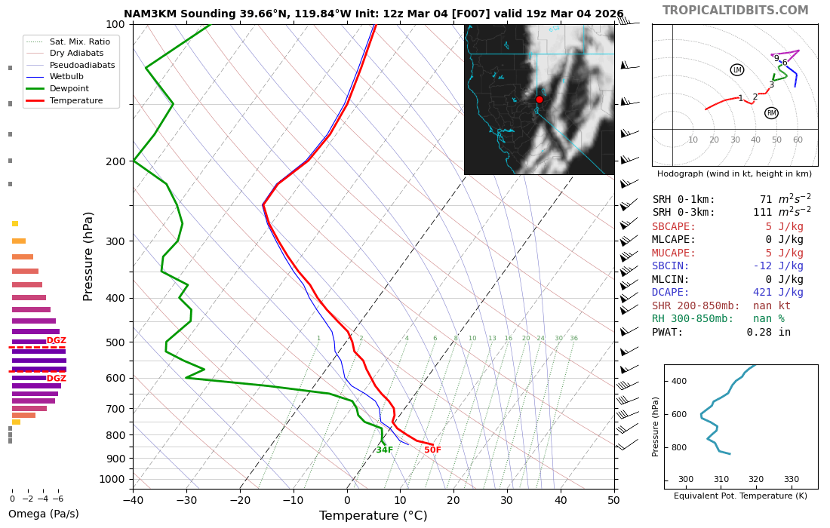

Slide 17
